Slide 1
Walk-in slide

Slide 2
AZ-204: Developing solutions for Microsoft Azure Introduction
Date

Slide 3
Hello!
Trainers:
Customize this content with your information, image, and background. Delete this note before publishing.
Thank you for joining me today
Instructor: <Name>
<Title or other credentials, e.g., Microsoft Certified Trainer>
<Affiliation/Company>
<A few words about my technical and professional experience>
twitter.com/[Name]
linkedin.com/[Name]
[first.last]@[email.com]
Blog

Slide 4
Let’s get to know each other
Your name
Company affiliation
Title/function
Your experience
Your expectations for the course

Slide 5


Let’s have a great time together
Trainers:
Customize this slide for your course. Delete this note before publishing.
We all contribute to a great class
What you should know about our facilities
This placeholder is designed with bulleted text
It’s easy to remove or add bullets
Be on time (class hours)
Be present (avoid mail, calls, side meetings)
This placeholder is designed with bulleted text
This section can be removed if the class is online
Accommodations
Internet access
Parking
Restrooms
Emergency

Slide 6
About this course
Cloud developer role
Microsoft Azure Developers design, build, test, and maintain cloud solutions, such as applications and services, partnering with cloud solution architects, cloud DBAs, cloud administrators, and clients to implement these solutions.
Prerequisites
At least one year of experience developing scalable solutions through all phases of software development.
Have a base understanding of Azure and cloud concepts, services, and the Azure Portal.
Much of the course focuses on C#, .NET Framework, HTML, and using REST in applications.
Are familiar with PowerShell and/or Azure CLI.

Slide 7
Course schedule
Trainers:
Find the proposed schedule in the Trainer Prep Guide (PDF) and customized if needed. Delete this note before publishing.
Day 1 | Day 2 | Day 3 | Day 4 | Day 5
Module 01: Implement Azure App Service web apps | Module 03: Develop solutions that use Blob storage | Module 05: Implement containerized solutions | Module 08: Implement API Management | Module 11: Troubleshoot solutions by using Application Insights
Lunch
Module 02: Implement Azure Functions | Module 04: Develop solutions that use Azure Cosmos DB | Module 06: Implement user authentication and authorization Module 07: Implement secure cloud solutions | Module 09: Develop event-based solutions Module 10: Develop message-based solutions | Module 12: Implement caching for solutions

Slide 8


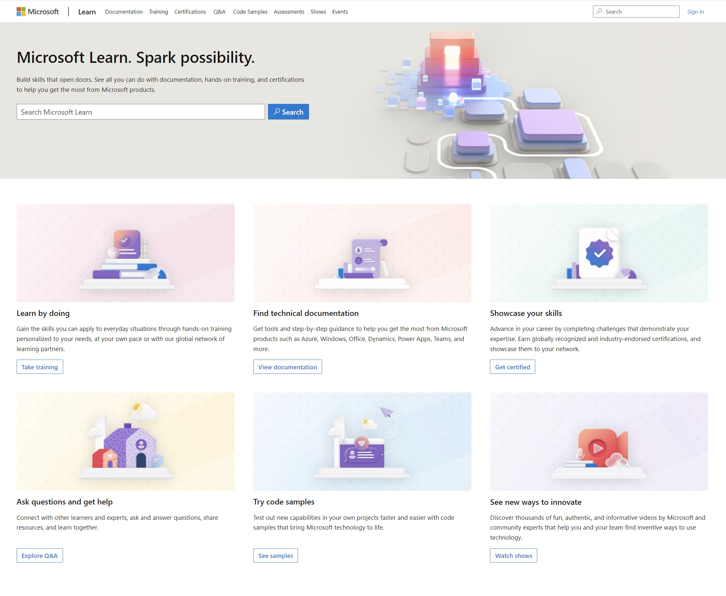
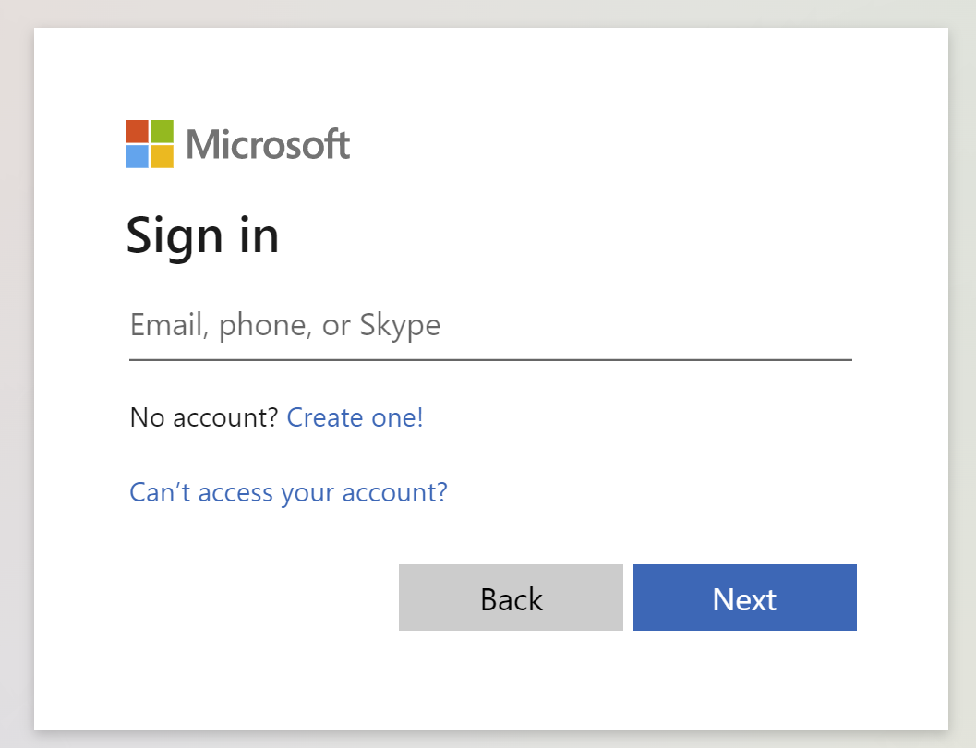
Get the most out of your Microsoft Learn profile
Create your Microsoft Learn profile at learn.microsoft.com
Select Sign in at the top, right corner of any Microsoft Learn page.
Follow the Microsoft account authentication process.
If the account that you have chosen to sign-in with doesn't already have a Microsoft Learn profile, you’ll be guided to create one.
Verify, track, and share your training and certification progress and accomplishments—all on one platform
Claim your achievement code for this course and share you have completed it.
Access your course material and track progress on your learning activities.
Share and verify your Microsoft Certifications via email, on social networking platforms, and on your résumé.
Download and print transcripts and certificates.
Manage your upcoming activities and certification exam appointments.
www.aka.ms/MyMicrosoftLearnProfile

Slide 9
Access your course material
All course content is available on Microsoft Learn
learn.microsoft.com/training/courses/browse
This course includes labs:
Detailed lab instructions are included in your lab environment.
We’ll go through this content together and as the course progresses, I will advise you on which modules to review.
You can provide feedback for modules on Microsoft Learn. Find how at the bottom of each page.
Notes:
Discuss the self-paced Learning Paths available from the exam page or by searching: https://learn.microsoft.com/certifications/exams/az-204/?tab=tab-learning-paths

Slide 10
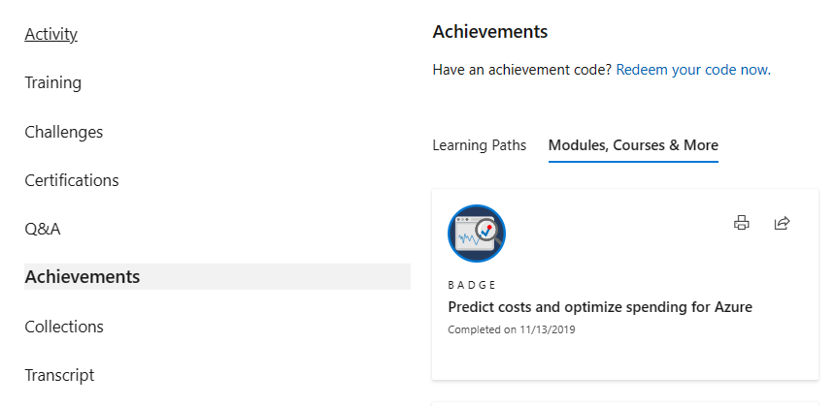
Celebrate your accomplishments and feel empowered
Get your achievement recognized and earn your badge for completing this course
aka.ms/MyMicrosoftLearnProfile
2
Go to Achievements on your Microsoft Learn profile
Redeem the code provided by your trainer
Find your new badge on Modules, Courses & More
Share your new achievement with your professional network. You can also download and print your certificate.
3
4
1

Slide 11

Become Microsoft Certified
92%
of certified IT professionals feel more confident in their abilities after earning certifications¹
Get recognized by earning industry validation for technical knowledge. Ensure you stay current with the necessary skills and expertise for continued success​.
Start at learn.microsoft.com/certifications
Microsoft role-based and specialty certifications require annual renewal.²
Learn about certification renewal at aka.ms/RenewYourCert
¹ “2023 Value of IT Certification | Candidate Report,” Pearson VUE, 2023 ² Microsoft fundamentals certifications don’t expire

Slide 12

Get ready for your Microsoft Certification exam
Exam AZ-204: Developing Solutions for Microsoft Azure
Understand the skills measured by the exam
Build confidence in your skills
Study area | Percentage
Develop Azure compute solutions | 25-30%
Develop for Azure storage | 15-20%
Implement Azure security | 20-25%
Manage user environments and apps | 20-25%
Monitor, troubleshoot, and optimize Azure solutions | 15-20%
Connect to and consume Azure services and third-party services | 15-20%
Find in the exam page resources to help prepare
Watch exam prep videos
Review the exam study guide
Demo the exam experience with the exam sandbox
Take a practice assessment
Percentages indicate the relative weight of each area on the exam
The higher the percentage, the more questions you are likely to see in that area

Slide 13
End of presentation

